Slide 1
Tutorial Week 4 Part I
Zibin Pan

Slide 2
Review
1. What is “Relation” in database?

Slide 3
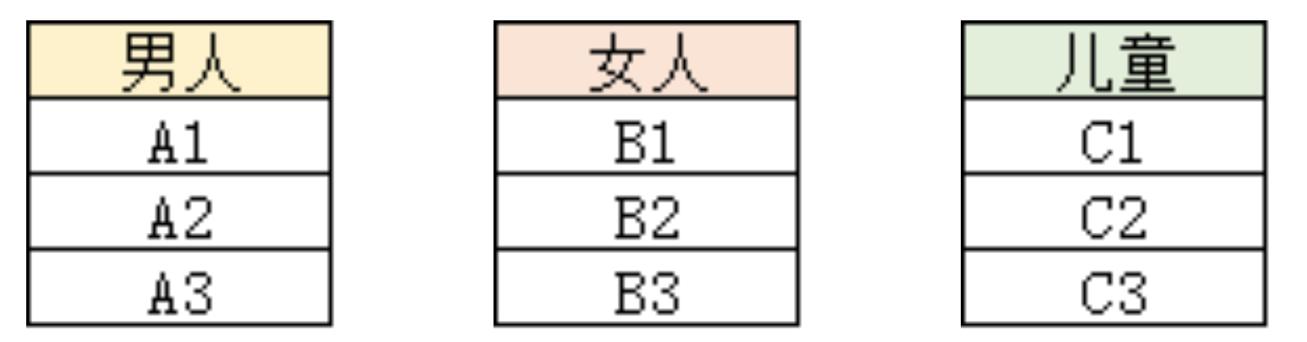
Denote D1 as a set of man that contains 3 elements: D1 := {A1, A2, A3}. Similarly, D2 := {B1, B2, B3}, D3 := {C1, C2, C3}.

Slide 4
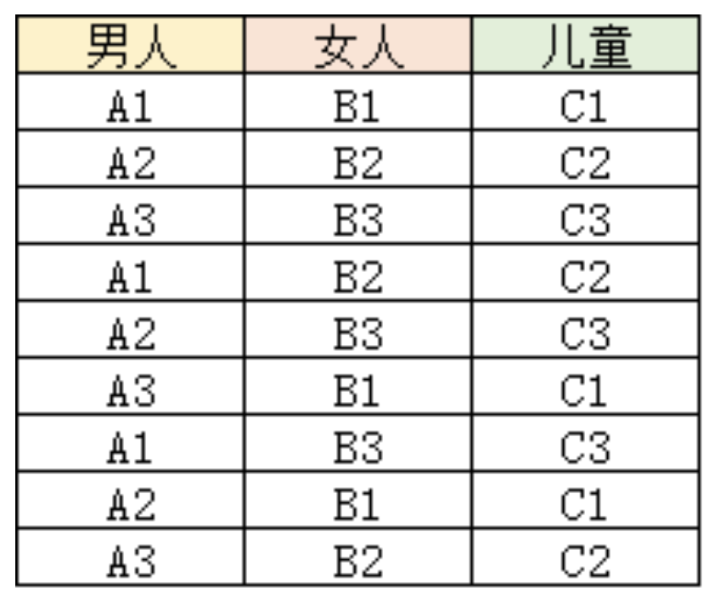
Intuitively, D1 * D2 * D3 can be seen in the following table:

Slide 5
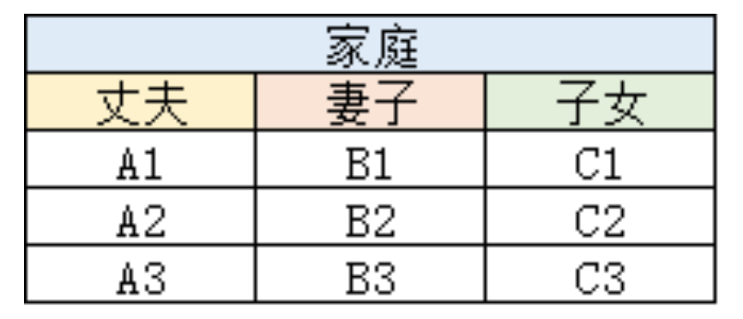
Obviously, this table is a little meaningless. It is just a combination of the data.
So, we can pick up some rows from this combined table to form another table:
This table records the information about the husband, the wife, and the child of each family. In database system, we call this table as “Relation”. And the “Husband”, “Wife”, and “Child” are called the attribute. The “Family” is the name of the relation.
We call each row of the table as “tuple”, or “record”.
“Relation Schema” is: Relation name + attributes
“Relation Instance” is: Relation name + attributes + actual data values.

Slide 6
2. What is “superkey”?

Slide 7
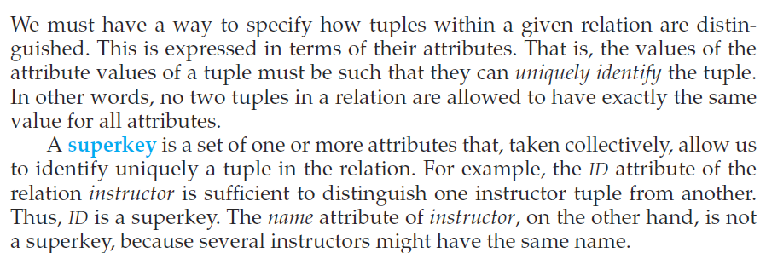

Slide 8
3. What’s “candidate key”?

Slide 9
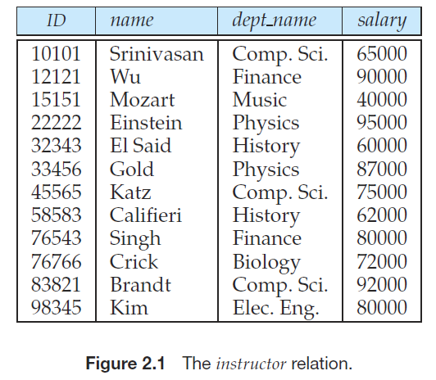
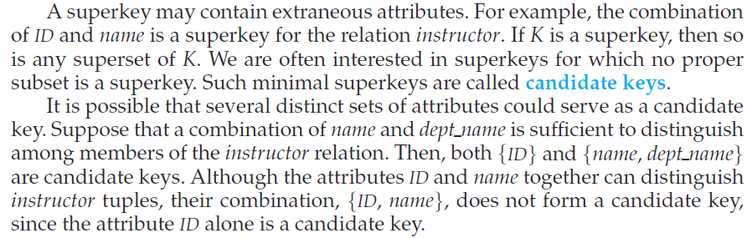

Slide 10
4. What is “primary key”?

Slide 11
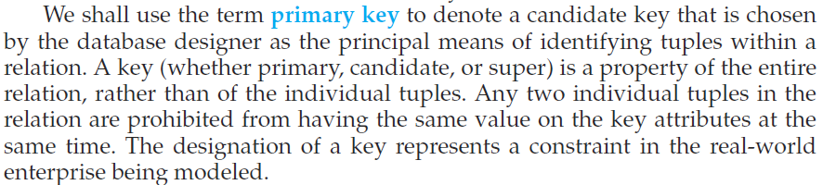
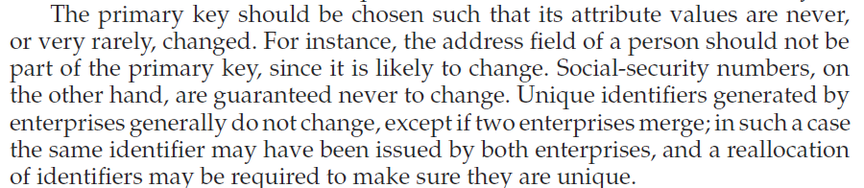

Slide 12
What’s the relationship between the superkey, candidate key and primary key?

Slide 13
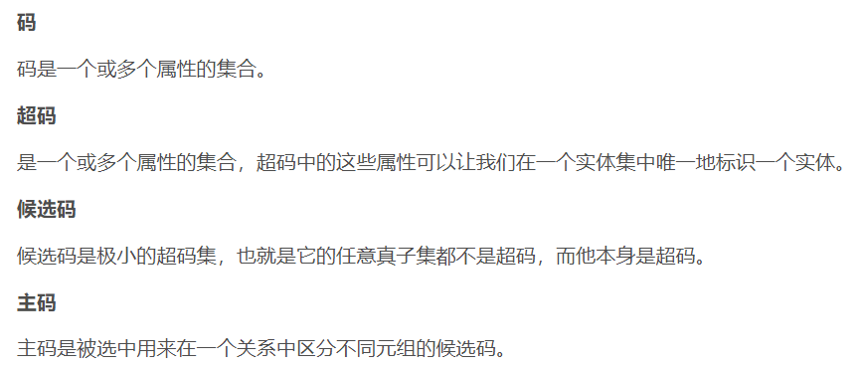

Slide 14
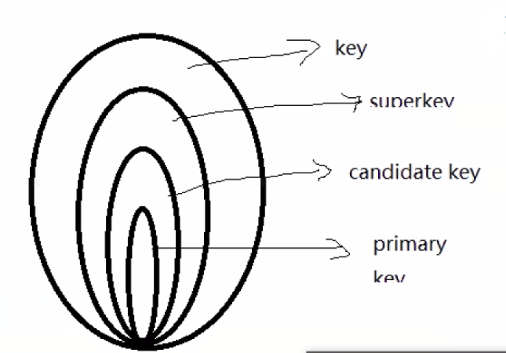

Slide 15
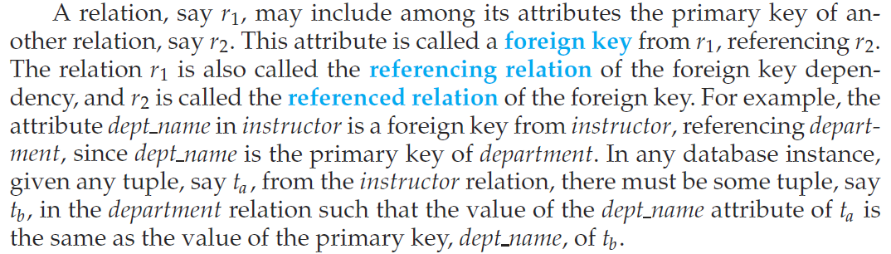
Foreign key

Slide 16
